Slide 1
CMPE 220
Week 6 – Linkers, Loaders, and IDEs
Notes:
Let’s talk about history.
California State Railroad Museum – 1976 - docents worked on original steam engines.

Slide 2
Building Software
High Level Language Source Code (e.g. C++)
Assembly Language Source Code
Object file (binary machine code and tables)
Compiler
Assembler
optional
Executable
file
In-Memory
Code
Linker
Loader
Hardware Execution

Slide 3
System Dependent Components
(Compilers not yet discussed)
Assembler | Linker | Loader
Parses assembly language source code Assigns addresses Assembles instructions Generates object (*.o) files Generates listings Reports errors | Links object files Relocates modules and adjusts addresses Generates executable file Reports errors | Relocates executable file Loads executable file Inserts startup / terminate code Launches executable file Reports errors
Operating System
Memory Management Process Management
Hardware
Instruction set Addressing modes Memory address space

Slide 4
The Link Step
Linkers combine multiple object (*.o) files into a single executable file
Linkers connect symbols defined in one code module (EXTDEFS) with symbol references in another module (EXTREFS)
The linker may automatically search system libraries for external routines (automatic linking)
Most systems require a link step, even for a single object file
The linker creates a properly formatted executable file
Object file (*.o) format differs from executable file format

Slide 5
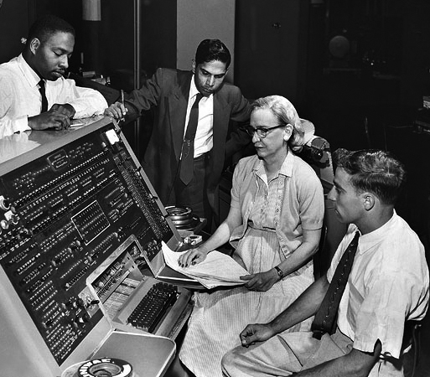
Historical Aside
As programs grew larger, it became desirable to break the development into several parts… and even to share parts of programs
One of the earliest linkers was developed by Grace Hopper in 1952
She called it a “compiler” because it compiled several parts into one program

Slide 6
Linker Relocation: (review)
Symbol Table
Note: some symbolic information that was important to the assembler is not needed for module relocation by the linker or the loader.
May still be important for symbolic debuggers
Symbol Reference Table
Symbol | Type | Address
LOOP | ADDR | 1017
INCR | ADDR | 1027
CONT | ADDR | 1055
COUNTER | ADDR | 1095
MAXINDEX | EQU | 300
Symbol | Type | Reference
EXPO | EXTREF | 1021
INCR | REF | 1026
LOOP | REF | 1030
LOOP | REF | 1048
COUNTER | REF | 1070
MAXINDEX | REF | 1076

Slide 7
Module Relocation: Linker
External Symbol Table
Modification Table holds the addresses of every instruction that contains an address (and therefore needs to be relocated).
new address = old address + new module base address
Modification Table
Symbol | Type | Address
Reference
1021
1026
1030
1048
1070
1076
External Symbol Reference Table
Symbol | Type | Reference
EXPO | EXTREF | 1021

Slide 8
Module Relocation: Linker
External Symbol Table
Modification Table holds a bit flag corresponding to every instruction that contains an address (and therefore needs to be relocated).
new address = old address + new module base address
Modification Table
Symbol | Type | Address
0 | 0 | 0 | 0 | 0 | 0 | 0 | 0
0 | 0 | 0 | 0 | 0 | 0 | 0 | 0
0 | 0 | 0 | 0 | 1 | 0 | 0 | 0
0 | 0 | 0 | 1 | 0 | 0 | 0 | 0
0 | 0 | 0 | 0 | 0 | 0 | 0 | 0
1 | 0 | 0 | 0 | 0 | 1 | 0 | 0
0 | 0 | 0 | 0 | 0 | 0 | 0 | 0
0 | 0 | 0 | 0 | 0 | 0 | 0 | 0
0 | 0 | 0 | 0 | 0 | 0 | 0 | 0
0 | 1 | 0 | 0 | 0 | 0 | 0 | 0
0 | 0 | 0 | 0 | 0 | 0 | 0 | 0
0 | 0 | 0 | 0 | 0 | 0 | 0 | 0
0 | 0 | 1 |  | 0 | 1 | 0 | 0
0 | 0 | 0 | 0 | 0 | 0 | 0 | 0
External Symbol Reference Table
Symbol | Type | Reference
EXPO | EXTREF | 1021

Slide 9
Dynamic Linking
On some systems, shared libraries are not linked into the executable file.
Instead, the linker inserts a call to a special system function for dynamic linking and loading (also called linking on demand).
Supported, with variations, on most modern platforms:
Windows: DLL (Dynamic Link Library) files
POSIX & Solaris: ELF (Executable and Linkable Format) files
MacOS: .dylib (Dynamic Library) files

Slide 10
Dynamic Linking Advantages
Reduces the memory footprint of the executable
Loads only routines that are actually used
Allows run-time binding, so different versions of shared library routines may be used
E.g. a version with debugging or tracing code
A single copy of a dynamic library may be shared among processes via MMU mapping.
An MMU, or Memory Mapping Unit, is a hardware device that maps addresses in a process address space to actual locations in physical memory

Slide 11
Shared Dynamic Libraries
Process 1 Address Space
Process 1 Address Space
Physical Memory
Process 2 Address Space
Program 1 Executable Code
Program 1 Executable Code
Program 2 Executable Code
Shared Dynamic Library
Shared Dynamic Library
Program 2 Executable Code
Shared Dynamic Library

Slide 12
Shared Dynamic Libraries (Data Separation)
Process 1 Address Space
Process 1 Address Space
Physical Memory
Process 2 Address Space
Program 1 Executable Code
Program 1 Executable Code
Program 2 Executable Code
Shared Dynamic Library
(code)
Shared Dynamic Library
(code)
Program 2 Executable Code
(Process 2 Data)
(Process 1 Data)
Shared Dynamic Library
(code)
(Process 1 Data)
(Process 2 Data)

Slide 13
The Load Step
Loads an executable file into memory
May relocate the file
Performs any required system initialization
Launches the program (starts execution)

Slide 14
Absolute Addressing
Predefined Addresses
1000
2000
3000
Program Main Module
Very early systems
Embedded systems
Routines can be located at pre-designated addresses
Separate assembly files
No linker required
Absolute Loader
Library 1 Module
Library 2 Module

Slide 15
Absolute Addressing Problem: code growth
Predefined Addresses
1000
2000
3000
Program Main Module
Very early systems
Embedded systems
Routines can be located at pre-designated addresses
Separate assembly files
Absolute Loader
Memory management is the responsibility of the programmer
Library 1 Module
Program Main (extra code)
Library 2 Module

Slide 16
Absolute Addressing – contiguous code
Predefined Starting Address – Contiguous Code
1000
2000
3000
Program Main Module
Very early systems
Embedded systems
Routines can be located at pre-designated addresses
Ways to generate:
Single assembly file (no linker)
Multiple files (linker required)
Absolute Loader
Library 1 Module
Library 2 Module

Slide 17
Absolute Loader
Loads an executable file, with a defined start address and size, into memory
“Code” format in the executable file may be binary, or character-encoded (e.g. hex character codes)
No relocation is needed at load time
Executable file may be generated from a single assembly source file, or may be linked.
Linker relocates modules in order to combine them into a single address space

Slide 18
Absolute Loader - Use Cases
“Primitive” machine – fixed address layout
Many embedded system
Bootstrap loader
Load the initial software (typically the OS) when a computer is started
A system that uses a hardware MMU – software doesn’t need to be relocated.

Slide 19
Relocating Loader
Linking / Loading with Relocation
1000
2000
3000
Program Main Module
With START Instruction
Assembler: set addresses based on START
Linker or Loader: update addresses
new address = old address – START + new module base address
Library 1 Module
Starts at 1720
Library 2 Module
Starts at 2176

Slide 20
Relocating Loader
Linking / Loading with Relocation
0
1000
2000
Program Main Module
Without START Instruction
Assembler: ignore START; set addresses based on 0
Linker or Loader: update addresses
new address = old address + new module base address
START instruction in assembly language is superfluous
Library 1 Module
Starts at 720
Library 2 Module
Starts at 1176

Slide 21
Program Relocation: Loader
Modification Table
A relocating loader, just like a linker, may use a modification table to determine locations that must be adjusted.
Modification Table
Reference
1021
1026
1030
1048
1070
1076
0 | 0 | 0 | 0 | 0 | 0 | 0 | 0
0 | 0 | 0 | 0 | 0 | 0 | 0 | 0
0 | 0 | 0 | 0 | 1 | 0 | 0 | 0
0 | 0 | 0 | 1 | 0 | 0 | 0 | 0
0 | 0 | 0 | 0 | 0 | 0 | 0 | 0
1 | 0 | 0 | 0 | 0 | 1 | 0 | 0
0 | 0 | 0 | 0 | 0 | 0 | 0 | 0
0 | 0 | 0 | 0 | 0 | 0 | 0 | 0
0 | 0 | 0 | 0 | 0 | 0 | 0 | 0
0 | 1 | 0 | 0 | 0 | 0 | 0 | 0
0 | 0 | 0 | 0 | 0 | 0 | 0 | 0
0 | 0 | 0 | 0 | 0 | 0 | 0 | 0
0 | 0 | 1 |  | 0 | 1 | 0 | 0
0 | 0 | 0 | 0 | 0 | 0 | 0 | 0

Slide 22
Terminology
Linker: Links multiple object (*.o) files into a single executable file
Linkage Editor: an old-fashioned term for linker.
Dynamic Linker: allows links to be made to shared library routines at run time (on demand)
Linker/Loader, or Linking Loader: links multiple object (*.o) files into a single executable file, which it then loads and runs
Loader: loads and runs an executable file
Absolute Loader: loads an executable file at its specified address in memory
Relocating Loader: relocates an executable file, allowing it be loaded at any address

Slide 23
Interactive Development Environments (IDEs)
High Level Language Source Code (e.g. C++)
Assembly Language Source Code
Object file (binary machine code and tables)
Compiler
Assembler
optional
Executable
file
In-Memory
Code
Linker
IDE / Debugger
Hardware Execution

Slide 24
IDEs: a Development Framework and Toolset
In the first lecture, we talked about:
Shells: used for a wide range of ad hoc and automated tasks (chiefly on POSIX systems)
Make: automates the program build process
IDEs are used during the development phase
IDEs:
contain system dependent components
impact the file formats of object files and executable files
add complexity to assemblers, linkers, and loaders

Slide 25
Interactive Development Environments
Interactive (typically GUI based)
Complete Development Environment:
“Smart” source code editor
Integration with program build systems (e.g. make)
Program debugger
Additional Tools:
Integration with version control systems
Visual layout editor
Code refactoring
Performance profiling

Slide 26
Why IDEs?
Unlike structured programming, IDEs do not represent a paradigm shift… they simply allow programmers to do common tasks more quickly and efficiently.
Smart Editor: because programmers spend more time editing than any other activity.
Debugger: because ongoing support is the greatest cost in the software lifecycle.

Slide 27
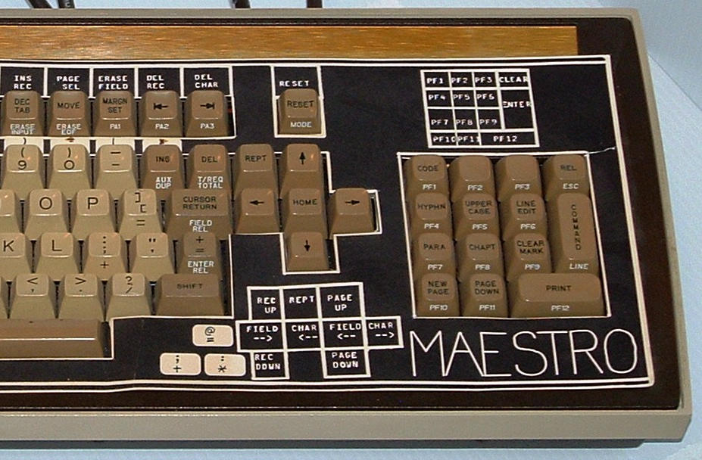
History
The first modern, GUI-based IDE was a commercial product, Maestro I, released by Softlab Munich in 1975
It was a leased hardware/software system, which included a custom keyboard and display
Turbo PASCAL – 1983
Visual Basic – 1991
Delphi - 1995

Slide 28
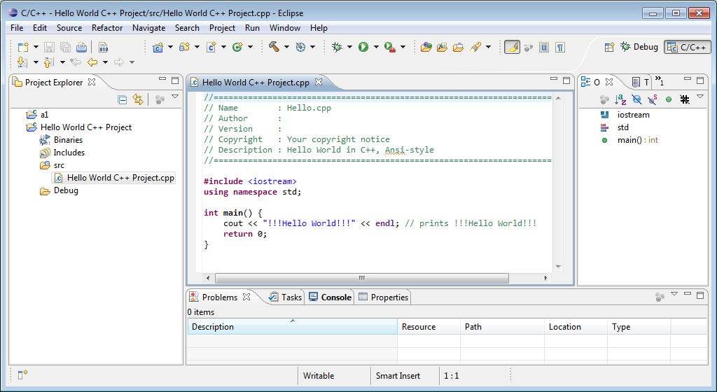
Eclipse – a Popular Open Source IDE

Slide 29
Most Popular IDEs
IDE | Developer
Visual Studio | Microsoft
Eclipse | Open Source
Xcode | Apple
Android Studio | Google (based on IntelliJ)
NetBeans | Oracle / Open Source
IntelliJ IDEA | Proprietary - JetBrains
PyCharm | Proprietary - JetBrains
Komodo | Proprietary - Komodo
Xojo (formerly RealBasic) | Proprietary - Xojo
Bash Shell | Open Source / POSIX

Slide 30
IDE Portability Versus Hardware Dependency
Feature | Machine Dependent?
Smart Editor / Code Editor | NO
Program Build | NO
Version Control | NO
File Browser | NO
High Level Language Support | NO
Code Refactoring | NO
Assembly Language Support | YES
Visual Layout Editor | YES
Performance Profiling | YES
Debugging | YES

Slide 31
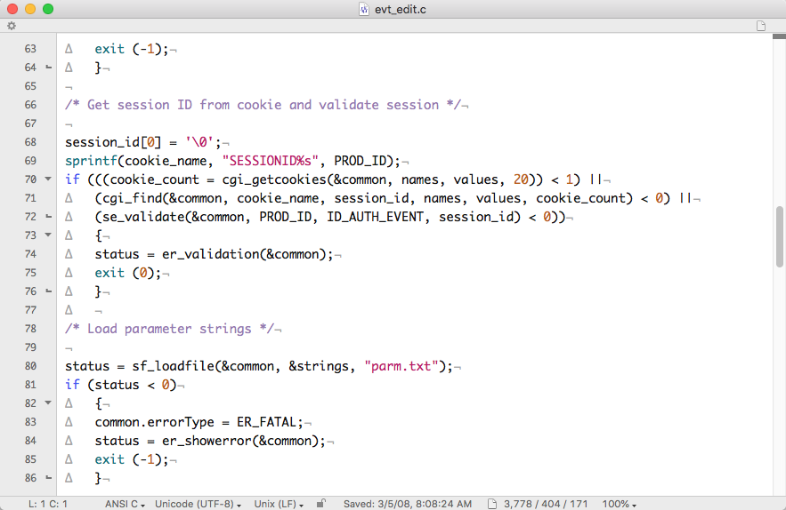
Smart / Code Editing
Multiple Languages
Syntax checking
Auto-complete
Indentation and code cleanup
Color coding (configurable)
Block checking / bracket matching / paren matching

Slide 32
Source Code Control / Version Control
Allows multiple people to collaborate on a project
Files are “checked in” to the version control system, and “checked out” for editing
Checking in files typically requires a list of changes (comments), allowing a kind of audit trail
The version control system stores all versions of a file, allowing users to revert to a previous version
Some version control systems allow the project team to manage “forks” and to intelligently merge forked versions.
New version versus bug fixes

Slide 33
Source Code Control: Checkpoints and Forks
When a project is “released” all files are checkpointed – given a Release number
Developers may later fork files to work on different versions independently
The Source Code Control System provides assistance for merging forked versions
Mylibrary.c
Release 1.0
fork
Mylibrary.c
Mylibrary.c
Mylibrary.c
Release 1.1
assisted
merge
Mylibrary.c
Release 2.0

Slide 34
Popular Version Control Systems
Version Control System | Model | Developer
Revision Control System (RCS) | Local | Open Source
Source Code Control System (SCCS) | Local | Open Source
Git | Distributed | Linus Torvalds / Open Source
Concurrent Versions System (CVS) | Client / Server | Open Source
Subversion (SVN) | Client / Server | Open Source
AWS CodeCommit (based on Git) | Distributed | Amazon
Team Foundation Server | Client / Server | Micrsoft
Rational ClearCase | Distributed | IBM
Mercurial | Distributed | Open Source
Many IDEs allow integration with multiple Version Control Systems

Slide 35
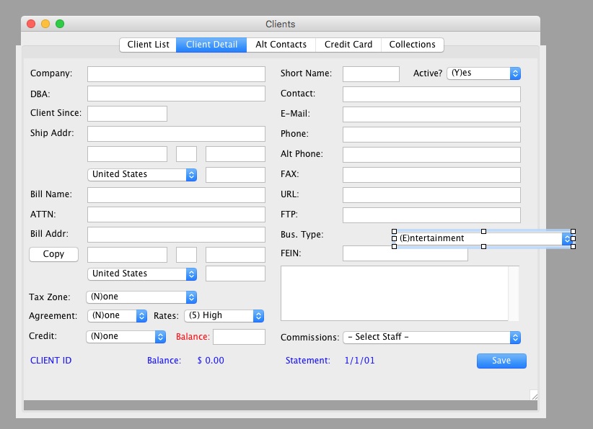
Visual Layout
Drag-and-Drop components
Attach code to components

Slide 36
Debugging (Sample GUI)
 |  | LDX | #0
 |  | STX | matches | matches = 0
 |  | STX | index | Index = 0
 | LOOP | LDX | index | Load the index
 |  | LDA | arraya, X | Get data from array A
 |  | COMP | arrayb, X | Compare to element in array B
 |  | JEQ | INCR | If they match, go incr count
 | CONT | LDA | index | Increment index by 3 bytes
 |  | ADD | #3
 |  | STA | index
 |  | COMP | end | “end” contains 300
 |  | JLT | LOOP | In index < limit, continue loop
Label | Addr | Byte Value | Word Value
LOOP | 1017 | 74 | 5330938
CONT | 1042 | 107 | 7410384
matches | 1062 | 0 | 12
arraya | 1066 | 2 | 135017
arrayb | 1365 | 3 | 204293
Insert Break
Delete Break
Run

Slide 37
Debugging
Label | Addr | Byte Value | Word Value
LOOP | 1017 | 74 | 5330938
CONT | 1042 | 107 | 7410384
matches | 1062 | 0 | 12
arraya | 1066 | 2 | 135017
Allows the user to view the address and content of memory locations by label
May allow different display formats (decimal, binary, hex, character, etc)
Allows the user to alter the content of memory locations
Allows users to view and alter register contents
Register | Byte Value | Word Value
A | 112 | 7810374
B | 44 | 2349534
X | 0 | 0

Slide 38
Debugging (Breakpoints)
(ANIMATE)
 |  | LDX | #0
 |  | STX | matches | matches = 0
 |  | STX | index | Index = 0
 | LOOP | LDX | index | Load the index
 |  | LDA | arraya, X | Get data from array A
 |  | COMP | arrayb, X | Compare to element in array B
 |  | JEQ | INCR | If they match, go incr count
 | CONT | LDA | index | Increment index by 3 bytes
 |  | ADD | #3
 |  | STA | index
 |  | COMP | end | “end” contains 300
 |  | JLT | LOOP | In index < limit, continue loop
Label | Addr | Byte Value | Word Value
LOOP | 1017 | 74 | 5330938
CONT | 1042 | 107 | 7410384
matches | 1062 | 0 | 12
arraya | 1066 | 2 | 135017
arrayb | 1365 | 3 | 204293
Insert Break
Delete Break
Run

Slide 39
Debugging (Breakpoints)
 |  | LDX | #0
 |  | STX | matches | matches = 0
 |  | STX | index | Index = 0
 | LOOP | LDX | index | Load the index
 |  | LDA | arraya, X | Get data from array A
 |  | COMP | arrayb, X | Compare to element in array B
 |  | JEQ | INCR | If they match, go incr count
 | CONT | LDA | index | Increment index by 3 bytes
 |  | ADD | #3
 |  | STA | index
 |  | COMP | end | “end” contains 300
 |  | JLT | LOOP | In index < limit, continue loop
Label | Addr | Byte Value | Word Value
LOOP | 1017 | 74 | 5330938
CONT | 1042 | 107 | 7410384
matches | 1062 | 0 | 12
arraya | 1066 | 2 | 134219
arrayb | 1365 | 2 | 134219
Insert Break
Delete Break
Run

Slide 40
Setting a Breakpoint
(ANIMATE)
Instruction Save Table
 |  | LDX | #0
 |  | STX | matches | matches = 0
 |  | STX | index | Index = 0
 | LOOP | LDX | index | Load the index
 |  | LDA | arraya, X | Get data from array A
 |  | COMP | arrayb, X | Compare to element in array B
 |  | JEQ | INCR | If they match, go incr count
 | CONT | LDA | index | Increment index by 3 bytes
 |  | ADD | #3
 |  | STA | index
 |  | COMP | end | “end” contains 300
 |  | JLT | LOOP | In index < limit, continue loop
1054 | JEQ | INCR
 | JSUB | BREAK | GIVE CONTROL TO IDE

Slide 41
Hitting a Breakpoint
Pseudocode
BREAK:
Save L Register (JSUB return address)
Save all Registers
Save CC (condition code)
Update Program Display (show position in code)
Update Memory Display (show values of memory locations)

Slide 42
Continuing After a Breakpoint
When the User Clicks RUN
Restore saved registers
Restore CC (condition code)
Execute Saved Instruction
Jump to return address (L register)

Slide 43
Impact on Memory and Addressing
Memory
IDE and Debugger
Debugger and program are a single process
Debugger and program reside in the same address space
Debugger needs to relocate program when loading it
Debugger is able to read and write program memory
Program
being
debugged

Slide 44
Breakpoints Using Interrupts
An interrupt is a hardware mechanism for interrupting the normal flow of program execution.
Causes an ‘immediate’ branch to an interrupt handler routine
Interrupts may be triggered by
A timer
An I/O operation
An instruction that triggers an interrupt

Slide 45
Setting a Breakpoint
(ANIMATE)
Instruction Save Table
 |  | LDX | #0
 |  | STX | matches | matches = 0
 |  | STX | index | Index = 0
 | LOOP | LDX | index | Load the index
 |  | LDA | arraya, X | Get data from array A
 |  | COMP | arrayb, X | Compare to element in array B
 |  | JEQ | INCR | If they match, go incr count
 | CONT | LDA | index | Increment index by 3 bytes
 |  | ADD | #3
 |  | STA | index
 |  | COMP | end | “end” contains 300
 |  | JLT | LOOP | In index < limit, continue loop
1054 | JEQ | INCR
For example only… the SIC instruction set does not have an INT (interrupt) instruction.
 | INT | 01 | GIVE CONTROL TO IDE

Slide 46
Impact on Memory and Addressing
Process 1 Address Space
Process 2 Address Space
IDE and Debugger
Program
being
debugged
Debugger and program are separate processes
Debugger and program each reside in their own address space
Debugger does not need to relocate program when loading it
Debugger must be able to read and write across address spaces

Slide 47
Requirements for Assembler, Linker & Loader
Write additional information to object (*.o) files and executable files
Code Table
Symbol Table
1017 |  | LDX | #0
1020 |  | STX | matches | matches = 0
1023 |  | STX | index | Index = 0
1026 | LOOP | LDX | index | Load the index
1029 |  | LDA | arraya, X | Get data from array A
1032 |  | COMP | arrayb, X | Compare to element in array B
1035 |  | JEQ | INCR | If they match, go incr count
1038 | CONT | LDA | index | Increment index by 3 bytes
1041 |  | ADD | #3
1044 |  | STA | index
1047 |  | COMP | end | “end” contains 300
1050 |  | JLT | LOOP | In index < limit, continue loop
Symbol | Type | Address / Value
LOOP | REF | 1017
CONT | REF | 1042
matches | REF | 1062
arraya | REF | 1066
arrayb | REF | 1365
index | REF | 1368

Slide 48
Debugging (High Level Languages)
status = cgi_get(&common, field_buffer, 1000);
field_count = cgi_vars(&common, field_buffer, names, values, 30);
code[0] = '\0’;
if ((cgi_find(&common, "code", &code, names, values, field_count) < 0) ||
{
strcpy(common.message, "You must select an event type to edit.");
common.errorType = ER_USER;
status = er_showerror(&common);
exit (0);
Label | Addr | Value
status | 1017 | 1
field_count | 1042 | 17
common | 1062 | structure
code | 1066 | array
field_buffer | 1365 | structure
Insert Break
Delete Break
Run

Slide 49
Debugging (High Level Languages)
The debugger must now be able to connect high-level source code statements to machine code addresses, to allow breakpoints
The debugger must understand and be able to display variable arrays, different data types, structures, etc.

Slide 50
Additional File Information
The information required by debuggers adds a great deal of data to the object and executable files
Typically an option when compiling, assembling, and linking: gcc –g
gcc -g generates debug information to be used by GDB debugger

Slide 51
For Next Thursday
Log in to Canvas and complete Assignment 3
Read Chapter 4 – Macro Processors

